Slide 1

INTRODUCTION TO AI (AI101B) Even Semester Session 2024-25
House Price Prediction Using ML
Group Members:
Nishant Raikwar (202410116100135)
Palak Goyal (202410116100138)
Rahul Rawat (202410116100159)
Nilesh Agrahari (202410116100134)
Project Supervisor:
Mr. Apoorv Jain
Assistant Professor

Slide 2








Content Page
1
Introduction
2
Problem Statement
3
Objective
4
Tools and Technologies Used
5
System Architecture
6
Features of the Application
7
Implementation Screens and Usage
8
Challenges and Solutions Faced During Development
9
Results and Testing
10
Conclusion
11
Future Scope

Slide 3

House Price Prediction Using Machine Learning
India's real estate market is booming thanks to rapid urbanization and economic expansion. Traditional property valuation methods, however, are often subjective, leading to unreliable price estimations that can confuse buyers and sellers. By applying machine learning and geographic information systems (GIS), we can revolutionize this landscape with accurate, data-driven predictions.
This presentation introduces a cutting-edge approach using ML models to predict house prices across India, helping real estate stakeholders make smarter and more confident decisions.

Slide 4

Problem Statement
Market Inefficiencies
Tool Deficiency
Current property price estimations are inconsistent, often varying widely due to subjective assessments.
There is a lack of accessible, user-friendly digital tools that integrate detailed features and location data.
Complex Market Dynamics
Existing solutions struggle to capture the complexity of India's diverse real estate market, such as Bangalore’s 20-30% price variation for similar properties.

Slide 5

Project Objective
1
Web App Development
Create an interactive web-based tool for house price prediction harnessing machine learning capabilities.
2
Multi-Model Training
Train and compare multiple regression algorithms including Decision Tree, Random Forest, KNN, Huber, and CatBoost to identify the most accurate.
3
GIS Integration
Plan to integrate Google Maps API for enhanced spatial data usage and location accuracy.
4
User Engagement
Provide buyers, sellers, and analysts with a real-time tool targeting 90% prediction accuracy within a ±5% margin.

Slide 6
Tools and Technologies
Programming & Libraries
Development & Visualization
Future Integrations
Python 3.9
Flask Web Framework 2.0
GIS capabilities using Google Maps API for richer spatial data integration to enhance prediction accuracy.
Pandas, NumPy
Frontend: HTML, CSS, JavaScript
Scikit-learn 1.2
Matplotlib & Seaborn for charts
CatBoost
Deployment on Render.com

Slide 7
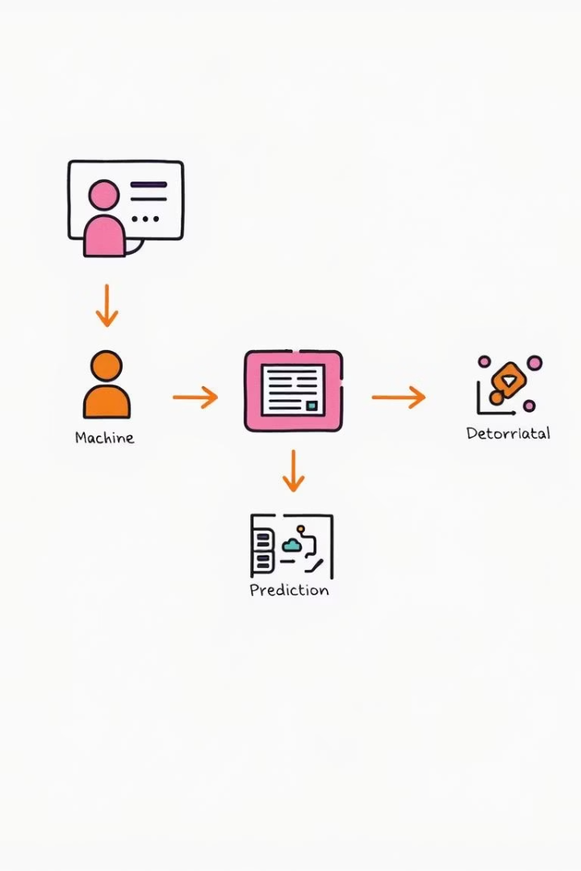




System Architecture
User Input
Users submit property details like area, location, and amenities via a web interface.
Data Processing
Backend Flask API preprocesses data, including encoding and cleaning.
ML Model Prediction
Trained regression models generate house price estimates in real-time.
Output Display
Results presented promptly on the frontend, aiding user decisions.
The backend stores models using Pickle serialization and is designed for scalability to serve 1000+ concurrent users, with plans for database upgrade to PostGres.

Slide 8

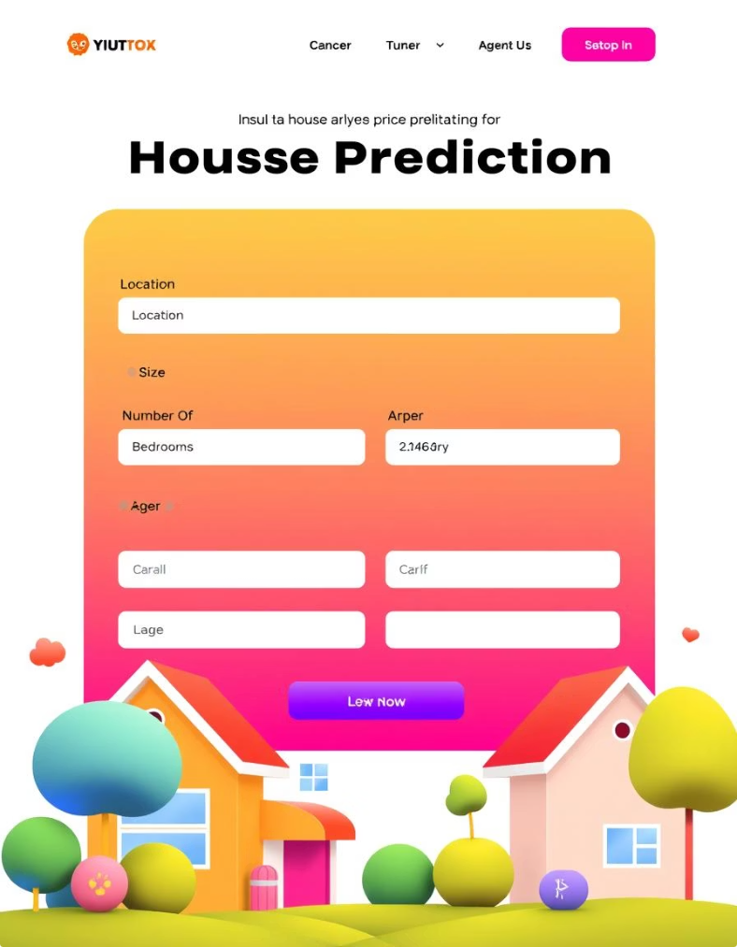




Key Features
Input Variables
Multiple Models
Location Encoding
Includes critical parameters like area (sq ft), number of bedrooms, bathrooms, and amenities.
Allows switching among regression models to enhance prediction reliability.
Encodes location data to provide context-sensitive and more accurate price evaluations.
Real-Time Interaction
User-friendly form updating predicted prices instantly upon data input.
Planned enhancement: integrating dynamic GIS maps to refine spatial accuracy.

Slide 9
Implementation and Usage
Home Page
Input Form
Output Screen
Clean interface welcoming users to enter property details.
Users specify location, property area, bedrooms, bathrooms, and amenities for prediction.
The app instantly displays the predicted price, e.g. for a 1200 sq ft 2BHK apartment in Mumbai.
This seamless flow ensures users get quick, actionable insights to support buying or selling decisions.

Slide 10

Challenges and Solutions
Missing Data
Handled placeholder values like '9' by applying Simple Imputer with most frequent strategy to maintain data integrity.
Location Complexity
Addressed varied geographic inputs via one-hot encoding to preserve essential spatial distinctions.
Model Accuracy
Improved predictions using ensemble models and robust 10-fold cross-validation with an 80/20 train/test split.
Interpretability
Enhanced understanding by visualizing feature importance, especially for complex models like CatBoost.

Slide 11
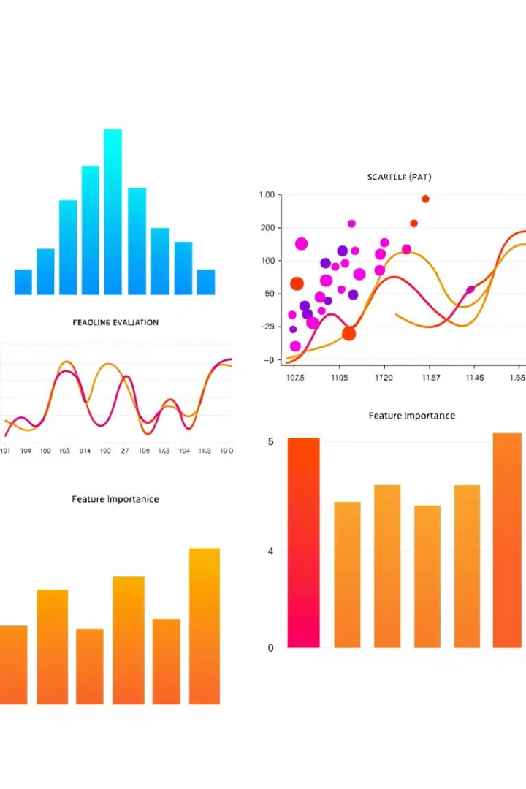
Results and Testing
1
Evaluation Metrics
Mean Absolute Error (MAE), Root Mean Squared Error (RMSE), and R² quantify model performance.
2
Top Model
CatBoost Regressor delivered highest accuracy with MAE of 40,000 INR and R² of 0.92.
3
Visual Analysis
Price distribution histogram comparing actual vs predicted
Prediction versus actual price scatter plot
Residual plot to detect errors systematically
Feature importance bar chart for model transparency

Slide 12

Conclusion and Future Scope
Conclusion
Machine learning significantly enhances accuracy of house price predictions in India's real estate sector.
Key Models
CatBoost and Random Forest stand out as reliable models supporting detailed prediction based on varied features.
Applications
The tool empowers buyers, sellers, and analysts by delivering precise, data-driven valuation insights in real-time.
Future Development
Focus on integrating GIS data, expanding coverage to more cities and incorporating live market trends and explainable AI models for transparency.
The vision is to achieve 95% prediction accuracy while ensuring a seamless user experience, revolutionizing property valuation in India.

